Slide 1
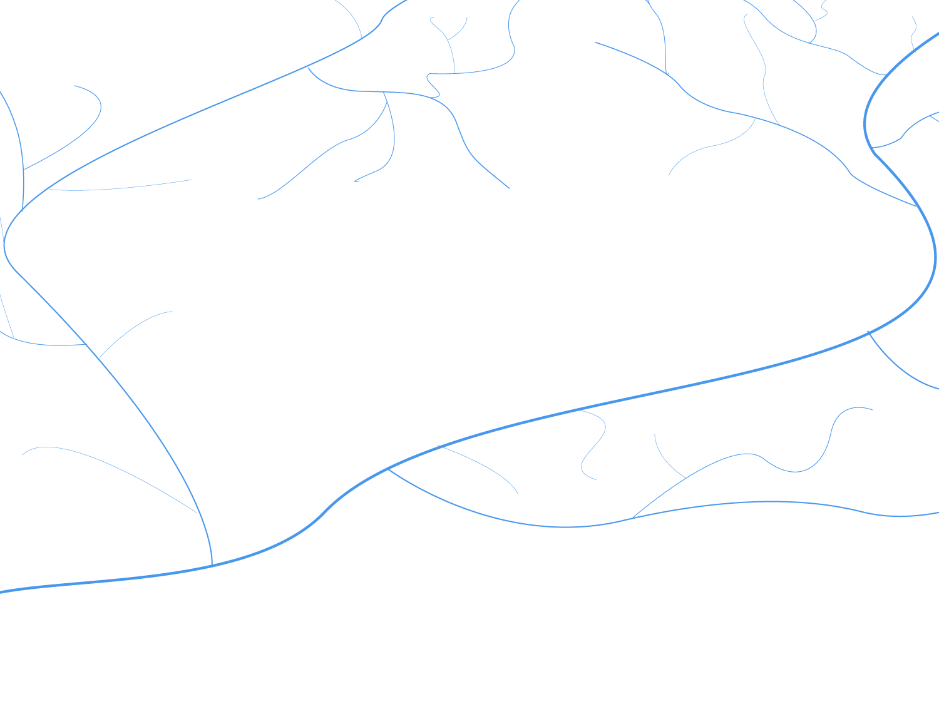
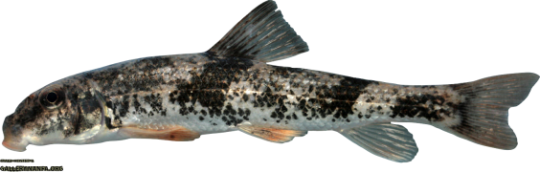

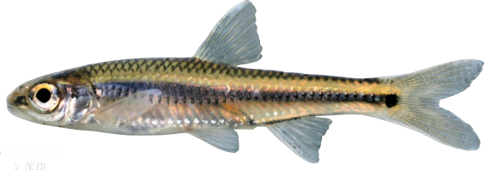

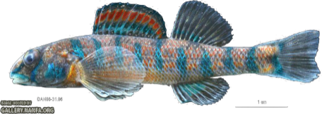
CSP4141 ~ Occupancy Modeling
Multi-Season Occupancy ~ Nuts & Bolts

Slide 2
Review: What is Occupancy?
Generally defined as:
The proportion or percentage of locations where a species is present
The probability that a species is present in a given location
Uses for Occupancy
Distribution
Habitat/resource use
Metapopulation dynamics
Biodiversity (species richness)

Slide 3
Review: Single Season Occupancy
Summary of Single season occupancy models
Historically, investigating patterns in occupancy has been the main focus of such studies.
Useful for assessing a snapshot of a species’ distribution.
Not as useful for understanding the underlying dynamics.
More on dynamics when we get to multi-season models ~ we have arrived!

Slide 4
Occupancy Review
S sampling units are selected to be sampled for a species.
Units are closed to changes in occupancy during a common ‘season’
Units are repeatedly sampled within a season
Units may be sampled over multiple seasons to monitor temporal changes in occupancy

Slide 5
Why Model Occupancy Dynamics?
Estimating abundance and population dynamics can be difficult, particularly for rare species
Occupancy modeling provides and efficient and effective framework for assessing population status
Dynamic occupancy modeling provides a framework for assessing changes in occupancy through time

Slide 6
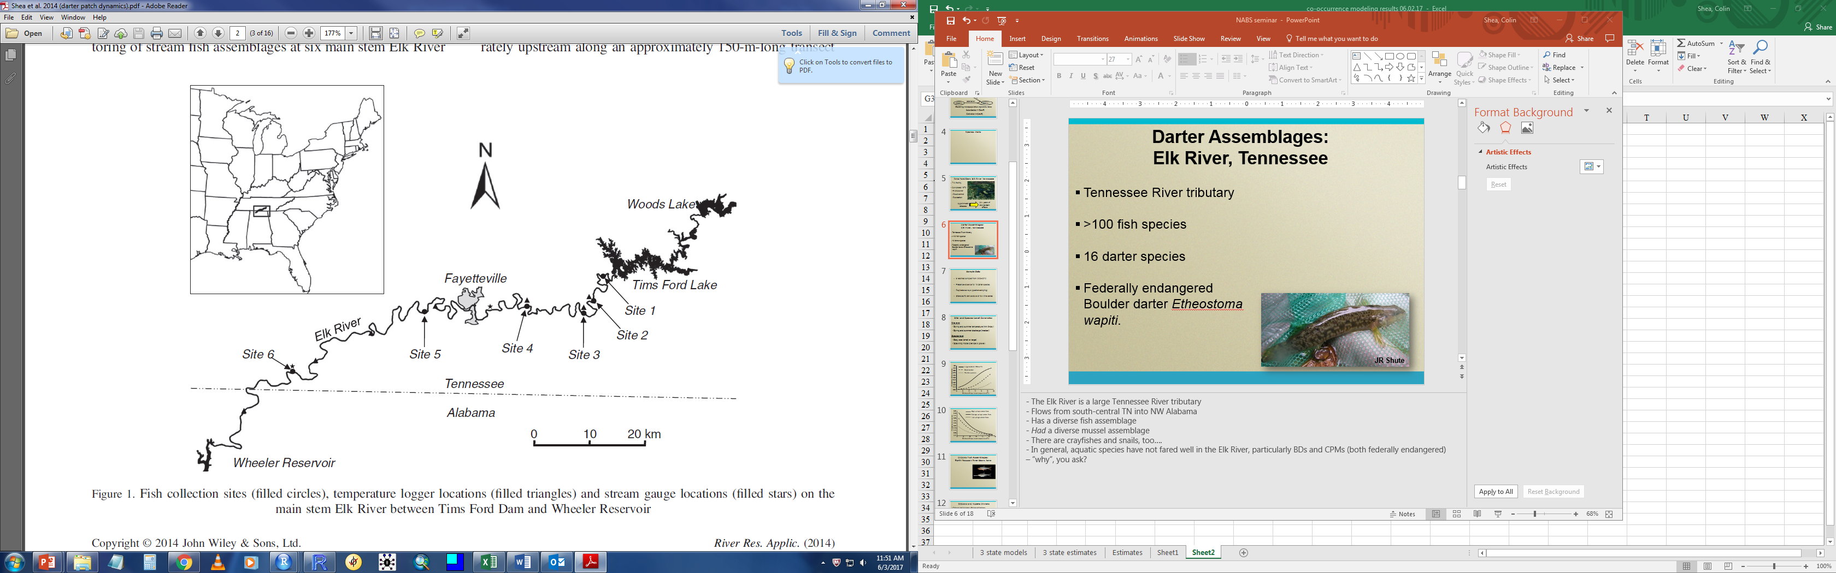
Dynamic Occupancy: Case Study
Darter Assemblages: Elk River, Tennessee

Slide 7
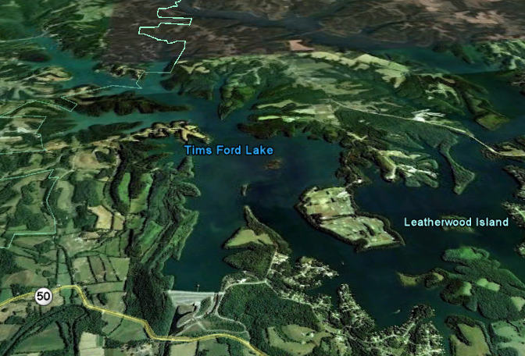
Case Study: Tims Ford Dam
TVA facility
Completed 1970
Hydropower
Flood control
Recreation
30+ years of downstream effects
Hypolimnetic releases

Slide 8
Case Study: Tims Ford Dam
Sample Data
6 reaches sampled annually from 2005-2012
Presence-absence data for 15 darter species
Replicate surveys (quadrat sampling)
Site-specific temperature & flow time series

Slide 9
Case Study: Tims Ford Dam
Site- and Species-Level Covariates
Site-level
Spring and summer temperature (min 5-day)
Spring and summer discharge (median)
Species-level
Body size (small or large)
Spawning mode (crevice or gravel)

Slide 10
Case Study: Tims Ford Dam
Large-bodied (>100mm TL)
Small-bodied
Crevice spawners
Probability of Colonization
Minimum 5-day stream temperature (◦C )

Slide 11
Case Study: Tims Ford Dam
High spring/summer flows
Average spring/summer flows
Low spring/summer flows
Probability of extinction
Minimum 5-day stream temperature (◦C )

Slide 12
Case Study: Tims Ford Dam
Models used to inform management and conservation.
Modify flow and temperature regimes
Promote colonization and persistence of target species in historically occupied stream reaches

Slide 13
Modeling Occupancy Dynamics
What is a “Season”?
A season is a period of time during which it is reasonable to assume occupancy is static or changes occur completely at random.
Depends very much on the target species and study objectives.
Is there a natural definition? (e.g., a breeding season)
How mobile is the species?

Slide 14
How to model multi-season data?
Option 1
Fit a single-season occupancy model to each season’s data
Ignores dynamic structure and potential information when same units are surveyed over time.
Potential for temporal autocorrelation, which violates the independence assumption.

Slide 15
How to model multi-season data?
Option 2
Fit a multi-season (dynamic) occupancy model.
Dynamic processes of occupancy are explicitly considered.
Incorporates a form of temporal autocorrelation in occupancy status of units.

Slide 16

Option 1: Fit a Single Season Model
Introduce structure to model systematic changes in occupancy, i.e., trends in occupancy:
Does not explicitly model the dynamic processes of occupancy resulting from local extinction and colonization events.
$$logit\left(ψ_{t}\right)=α+β_{t}$$

Slide 17
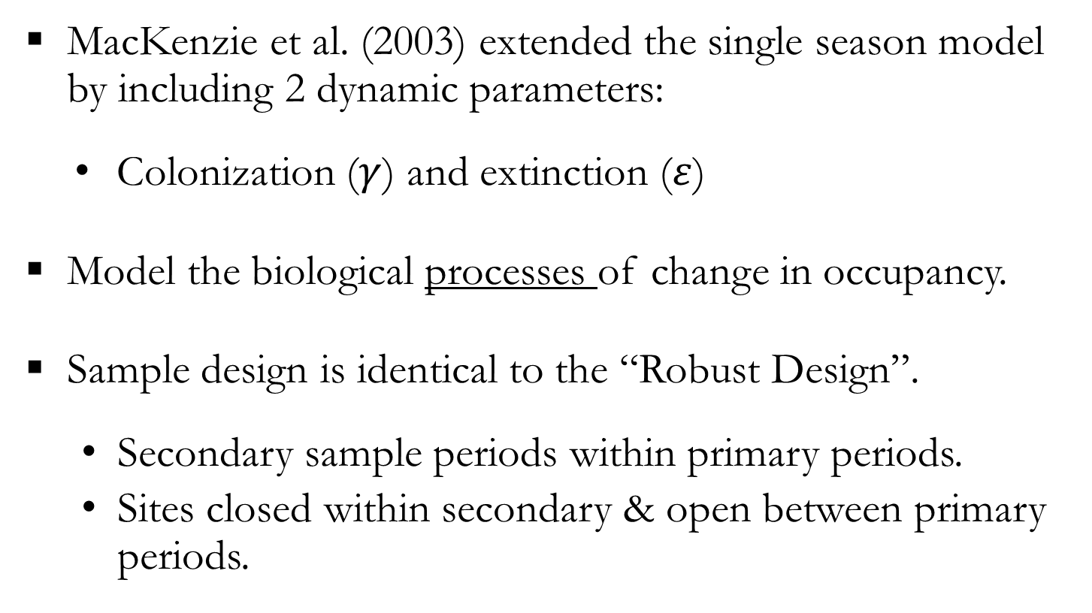
Option 2: Fit a Multi-Season Model
MacKenzie et al. (2003) extended the single season model by including 2 dynamic parameters:
Colonization ($γ$) and extinction ($ε$)
Model the biological processes of change in occupancy.
Sample design is identical to the “Robust Design”.
Secondary sample periods within primary periods.
Sites closed within secondary & open between primary periods.

Slide 18
Occupancy Dynamics
Colonization
Season 1
Season 2
Persistence
Extinction
(filled represents and occupied site)

Slide 19
Multi-Season Occupancy Data
Season 1
Season 2
Season 3
Occupied
Unoccupied
Occupied
Primary Occasions
Secondary Occasions
Detected
Not detected
Detected
Not Detected
Not Detected
Not Detected
Not Detected
Detected
Not Detected
Detection history (H)
101
000
010

Slide 20
Multi-Season Occupancy Data
 | Season
Unit | 1 | 2 | … | T
1 | 101 | 001 | … | 011
2 | 000 | 100 | ... | 110
3 | 100 | 000 | ... | 000
. | . | . | ... | .
. | . | . | ... | .
. | . | . | ... | .
. | . | . | ... | .
S | 000 | 000 | ... | 000

Slide 21
Multi-Season Occupancy Parameters
Season 1
Season 2
Season 3
1-ε₁
1-ε₂
Occupied (ψ₁)
ε₁
ε₂
γ₁
γ₂
Unoccupied (1-ψ₁)
1-γ₁
1-γ₂

Slide 22
Multi-Season Occupancy Parameters
ψ₁ = probability a site is occupied by the species in season 1
ε_{t} = probability a site becomes unoccupied by the species between seasons t and t+1
γ_{t} = probability a site becomes occupied between seasons t and t +1
p_{t,j} = probability the species is detected at a site in survey j of season t (given presence)

Slide 23
Incomplete Detection
Complication: Incomplete detection
Variability in detection can be related to a variety of factors:
Weather
Physical habitat characteristics
Local animal abundance
Species-specific differences
In short…things that can also affect occupancy dynamics

Slide 24
Detection Histories
Example detection history 1,
Verbal description: the species was present at the unit in season 1, where it was detected in first and third surveys, but not detected in the second survey. Between seasons, species persisted (did not go locally extinct) but was never detected in season 2.

Slide 25
Detection Histories
Example detection history 1,
Verbal description: the species was present at the unit in season 1, where it was detected in first and third surveys, but not detected in the second survey. Between seasons, species persisted (did not go locally extinct) but was never detected in season 2.
OR the species went locally extinct between seasons 1 and 2.

Slide 26
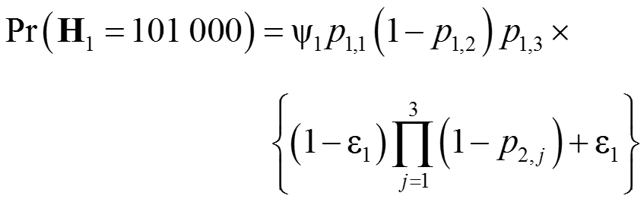
Detection Histories
Example detection history 1,
Mathematical translation:
(1 – ε₁) = persistence
p’s indexed by year, occasion

Slide 27
Detection Histories
Example detection history 2,
Verbal description: the species was present in season 1, but never detected, persisted (didn’t go locally extinct) between seasons, and was detected in the second survey during season 2.

Slide 28
Detection Histories
Example detection history 2,
Verbal description: the species was present in season 1, but never detected, persisted (didn’t go locally extinct) between seasons, and was detected in the second survey during season 2.
OR…the species was absent in season 1, colonized the unit between seasons, and was detected in the second survey during season 2.

Slide 29

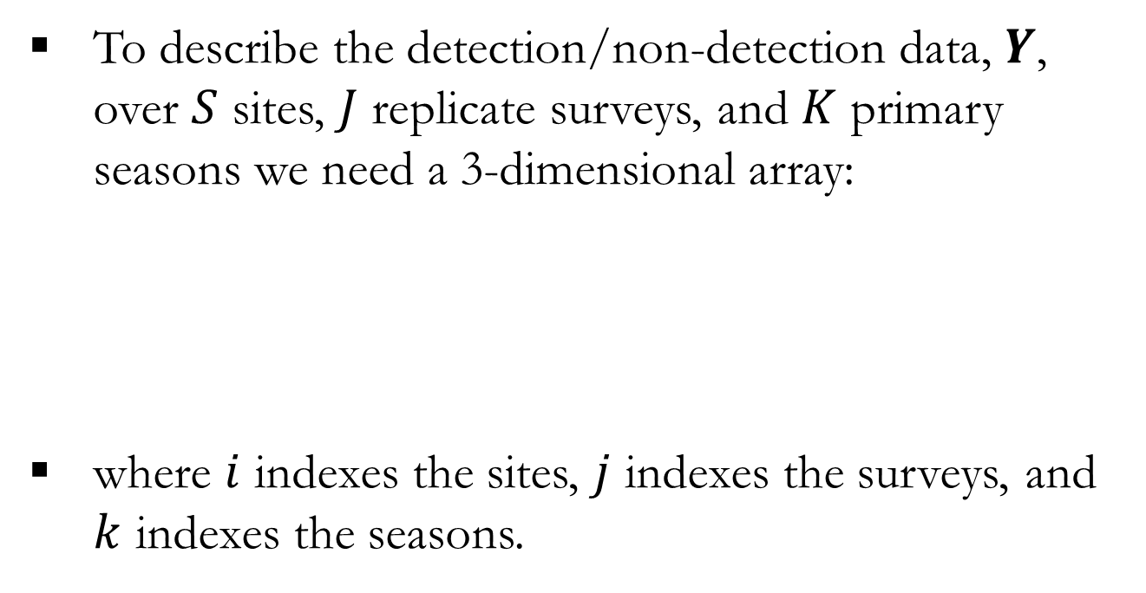
Hierarchical Formulation
To describe the detection/non-detection data, $Y$, over $S$ sites, $J$ replicate surveys, and $K$ primary seasons we need a 3-dimensional array:
where $i$ indexes the sites, $j$ indexes the surveys, and $k$ indexes the seasons.
$$Y=y_{i,j,k}$$

Slide 30

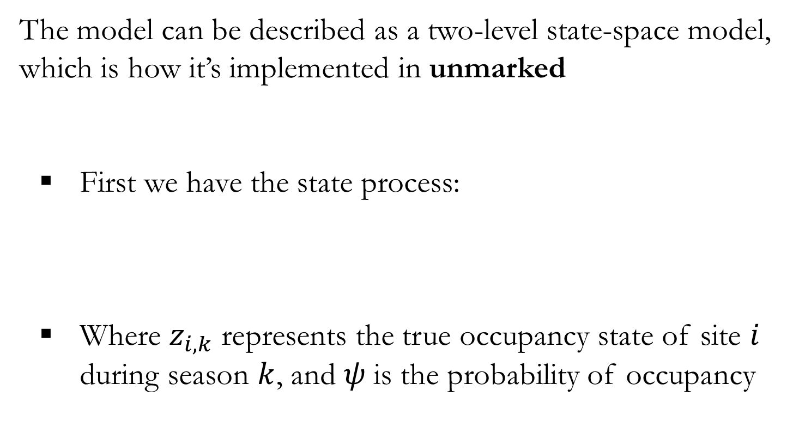
Hierarchical Formulation
The model can be described as a two-level state-space model, which is how it’s implemented in unmarked
First we have the state process:
Where $z_{i,k}$ represents the true occupancy state of site $i$ during season $k$, and $ψ$is the probability of occupancy
$$z_{i,k}\sim Bernoulli(ψ_{i,k})$$

Slide 31

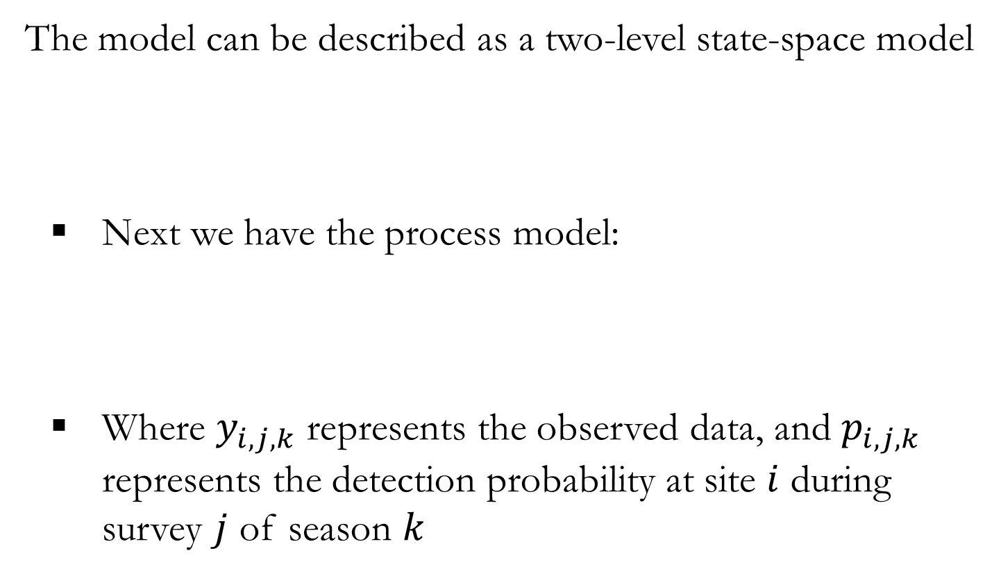

Hierarchical Formulation
The model can be described as a two-level state-space model
Next we have the process model:
Where $y_{i,j,k}$ represents the observed data, and $p_{i,j,k}$ represents the detection probability at site $i$ during survey $j$ of season $k$
$$z_{i,k}\sim Bernoulli(ψ_{i,k})$$
$$y_{i,j,k}\sim Bernoulli(z_{i,k}∗p_{i,j,k})$$

Slide 32

Hierarchical Formulation
At this point we could fit a single season occupancy with an index for season (recall Option 1); however, we can also now add dynamics:
For season 1 our state model remains the same:
For each additional season we can explicitly model the occupancy state transitions:
$$z_{i,1}\sim Bernoulli(ψ_{i,1})$$
$$z_{i,k+1}\sim Bernoulli(z_{ik}∗{(1−ε}_{i,k})+\left(1−z_{i,k}\right)∗γ_{i,k})$$

Slide 33
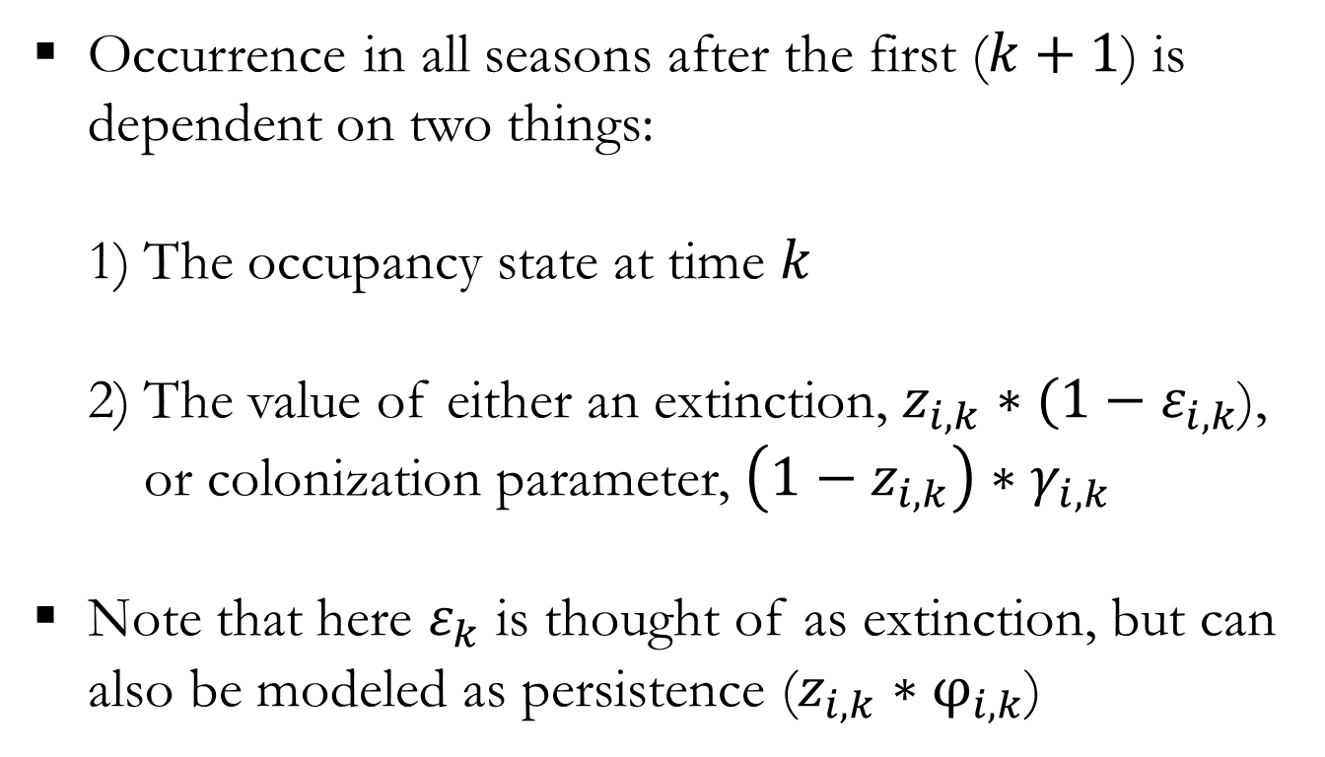
Hierarchical Formulation
$$z_{i,k+1}\sim Bernoulli(z_{i,k}∗(1−ε_{i,k})+\left(1−z_{i,k}\right)∗γ_{i,k})$$
Occurrence in all seasons after the first ($k+1$) is dependent on two things:
The occupancy state at time $k$
The value of either an extinction, $z_{i,k}∗(1−ε_{i,k}$), or colonization parameter, $\left(1−z_{i,k}\right)∗γ_{i,k}$
Note that here $ε_{k}$ is thought of as extinction, but can also be modeled as persistence ($z_{i,k}∗φ_{i,k}$)

Slide 34
Fitting a Dynamic Occupancy Model
Various programs are available for fitting multi-season occupancy models (and variants; see next slide).
MARK/RMARK
PRESENCE/RPRESENCE
Unmarked
BUGS/JAGS

Slide 35
Extensions
Can be extended to other types of occupancy models:
Multiple-states
Multiple-species
Multiple-scales
Various combinations of the above…

Slide 36
Multi-Season Occupancy Summary
Multi-season occupancy is useful for:
Evaluating trends in occupancy over time.
Estimating meta-demographic parameters: extinction and colonization.
Evaluating influence of abiotic/biotic factors on meta-demographic parameters.
Evaluating biological hypotheses regarding species dynamics.

Slide 37
Follow-along Exercises
See rMarkdown files:
“8. Multiple Season Occupancy Models.docx”
“9. Multiple Season Occupancy Simulation.html”

